Slide 1
RISC AND CISC ARCHITECTURE

Slide 2
RISC
RISC :- Reduced Instruction Set Computer Processor
A microprocessor architecture with a simple collection and highly customized set of instructions.
It is built to minimize the instruction execution time by optimizing and limiting the number of instructions.
It means each instruction cycle requires only one clock cycle, and each cycle contains three parameters: fetch, decode and execute.
RISC chips require several transistors, making it cheaper to design and reduce the execution time for instruction.

Slide 3
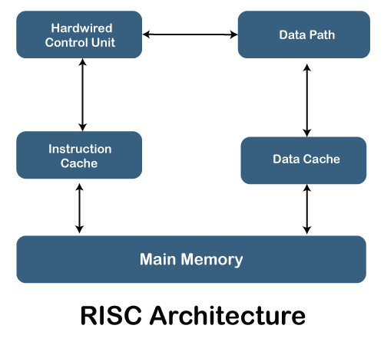
RISC Architecture

Slide 4
Features of RISC Processor
One cycle execution time: For executing each instruction in a computer, the RISC processors require one CPI (Clock per cycle).
Pipelining technique: The pipelining technique is used in the RISC processors to execute multiple parts or stages of instructions to perform more efficiently.
A large number of registers: RISC processors are optimized with multiple registers that can be used to store instruction and quickly respond to the computer and minimize interaction with computer memory.
It supports a simple addressing mode and fixed length of instruction for executing the pipeline.
It uses LOAD and STORE instruction to access the memory location.
Simple and limited instruction reduces the execution time of a process in a RISC.

Slide 5
CISC
CISC:-Complex Instruction Set Computer
It has a large collection of complex instructions that range from simple to very complex and specialized in the assembly language level, which takes a long time to execute the instructions.
CISC approaches reducing the number of instruction on each program and ignoring the number of cycles per instruction.
CISC chips are relatively slower as compared to RISC chips but use little instruction than RISC.

Slide 6
Features of CISC Processor
The length of the code is shorts, so it requires very little RAM.
CISC or complex instructions may take longer than a single clock cycle to execute the code.
Less instruction is needed to write an application.
It provides easier programming in assembly language.
Support for complex data structure and easy compilation of high-level languages.
It is composed of fewer registers and more addressing modes, typically 5 to 20.
Instructions can be larger than a single word.
It emphasizes the building of instruction on hardware because it is faster to create than the software.

Slide 7
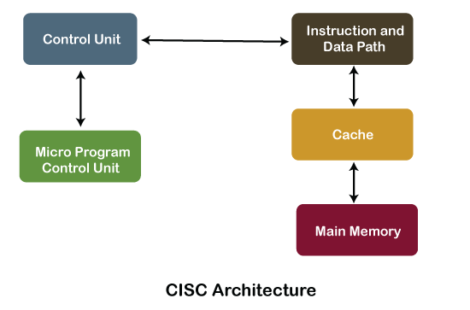
CISC Architecture

Slide 8
RISC | CISC
1. RISC stands for Reduced Instruction Set Computer. | 1. CISC stands for Complex Instruction Set Computer.
2. RISC processors have simple instructions taking about one clock cycle. The average clock cycle per instruction (CPI) is 1.5 | 2. CSIC processor has complex instructions that take up multiple clocks for execution. The average clock cycle per instruction (CPI) is in the range of 2 and 15.
3. Performance is optimized with more focus on software | 3. Performance is optimized with more focus on hardware.
4. It has no memory unit and uses separate hardware to implement instructions.. | 4. It has a memory unit to implement complex instructions.
5. It has a hard-wired unit of programming. | 5. It has a microprogramming unit.
6. The instruction set is reduced i.e. it has only a few instructions in the instruction set. Many of these instructions are very primitive. | 6. The instruction set has a variety of different instructions that can be used for complex operations.
7. Complex addressing modes are synthesized using the software. | 7. CISC already supports complex addressing modes
8. Multiple register sets are present | 8. Only has a single register set
9. RISC processors are highly pipelined | 9. They are normally not pipelined or less pipelined
10. The complexity of RISC lies with the compiler that executes the program | 10. The complexity lies in the microprogram
11 Execution time is very less | 11. Execution time is very high
12. Code expansion can be a problem | 12. Code expansion is not a problem
13. The decoding of instructions is simple. | 13. Decoding of instructions is complex
14. The most common RISC microprocessors are Alpha, ARC, ARM, AVR, MIPS, PA-RISC, PIC, Power Architecture, and SPARC. | 14. Examples of CISC processors are the System/360, VAX, PDP-11, Motorola 68000 family, AMD, and Intel x86 CPUs.
15. RISC architecture is used in high-end applications such as video processing, telecommunications, and image processing. | 15. CISC architecture is used in low-end applications such as security systems, home automation, etc.

